Slide 1
PART IV
Chuhan-Data set preservation & machine learning

Slide 2
My work is to set up neural network models and to test which of the five method has the best effect, and I also tried some way to improve the accurancy.

Slide 3
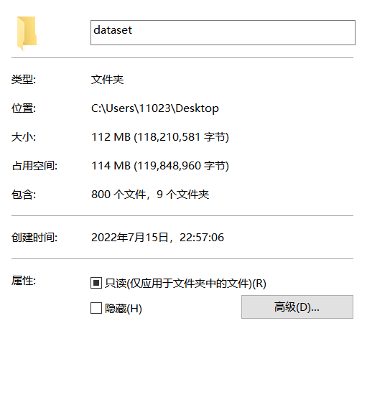

We made dataset with totally 800 images
And we set 400 images (200 for oil-polluted and 200 for normal sea) to train, and 200 (100 for oil-polluted and 100 for normal sea) each to validation and test.

Slide 4
In order to run a dataset, we need to divide the images into 3 files, validation, test and train. Train need more images so I put 400(200 for normal and 200 for polluted). Test and train I separately put 200(100 normal and 100 polluted).

Slide 5
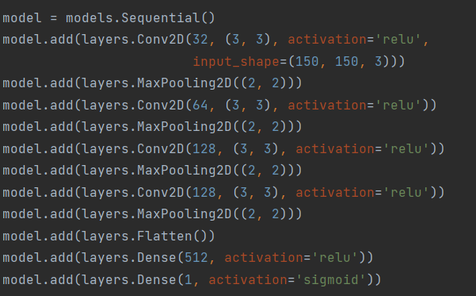
Firstly: I made a neural network by myself but the accuracy is not so well.

Slide 6
I need to set up neural network firstly. I choose to use Keras and python. Next, I tried to add some layers to make a model totally by myself, and the code is above but the accuracy is not so well after tested.

Slide 7
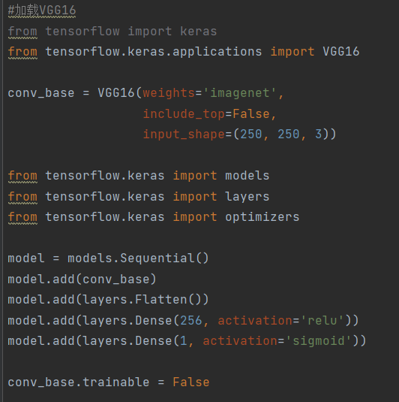
Then I learned about the VGG16 model, which is a pre-trained network and can be modified.
The VGG16 is more powerful than the early one I made, so I choose VGG16.

Slide 8
VGG16 is a powerful pre-trained model and we can add some dense layers to its end then we can use it, and it is powerful than the first model.

Slide 9
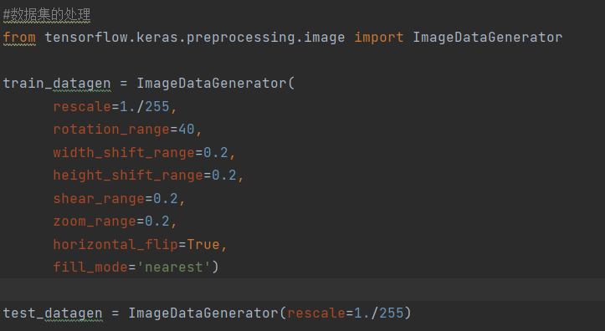
Then I also learned data augmentation, which can augment out dataset by some image processing methods.

Slide 10
Data augment is a way to increase the dataset by some basic image processing ways such as rotate, zoom… by using this way can we improve the number of the images from 800 to maybe over thousands, and it is really useful because our dataset is so small.

Slide 11
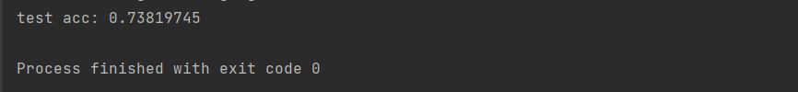
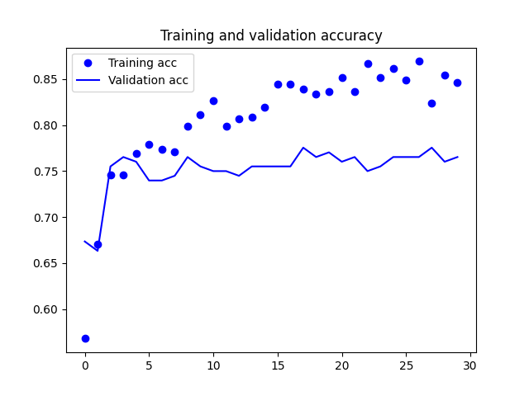
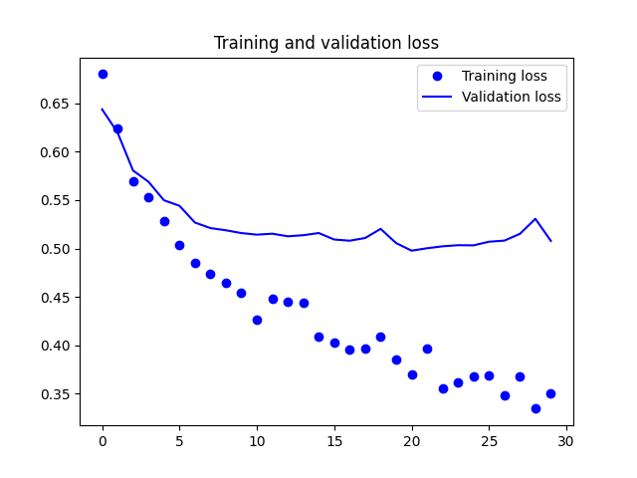
So finally I choose VGG16 + DA, and here is the accuracy:

Slide 12
Firstly I need to make a claim that all of the training I show next I actually have run over 50 epochs to find by which epochs the model become overfitting( for example 30 epochs, overfitting), then I only show the 30 epochs training result. The picture on the left is accurancy plot, and we can see the training and validation accurancy. The picture on the right is the loss plot. At the time validation loss do not decrease mean the model start to overfitting. Finally the image above is the test accurancy and this accurancy can show the true ability of the model.

Slide 13

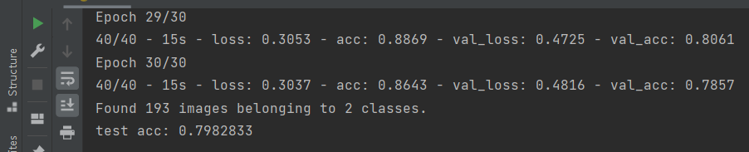
To improve the accuracy, we tried several method:
First I changed the input size of the images from (150,150,3) to (250,250,3), because the key point to classify is to find the contrast boundary between oil and sea, so larger size will contain more information and the accuracy improved.

Slide 14
To make the train image bigger is a good way to improve the accurancy because the key is to find the contract boundary so I make the input images bigger.

Slide 15

Then we tried to make the image more contrast.

Slide 16
The ppt below show different ways’ accurancy, and the detailed method is made by my teammates, I only use them to do the test and choose one best way to improve the accurancy.

Slide 17
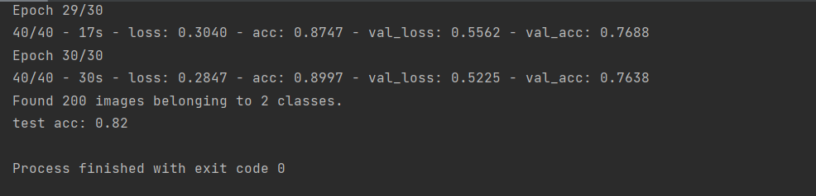
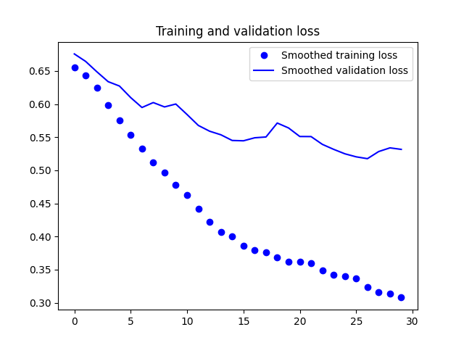
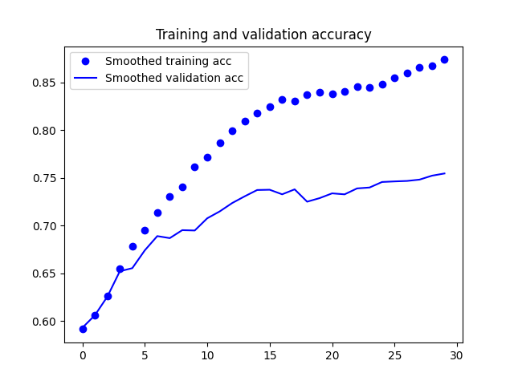
Next I compared different method: m1

Slide 18
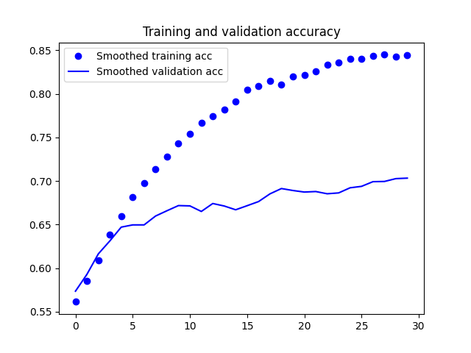
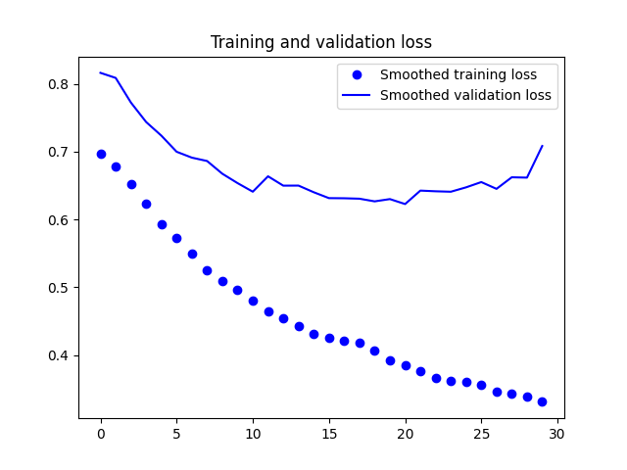
Method 2

Slide 19
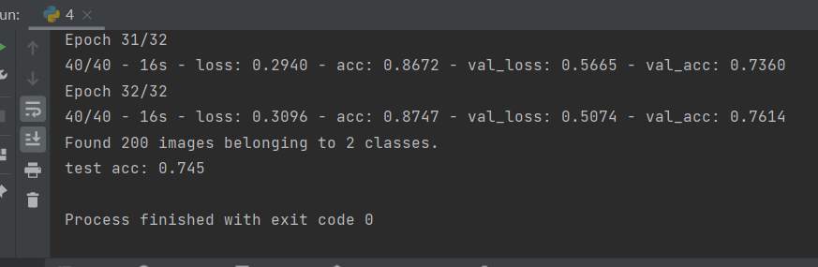
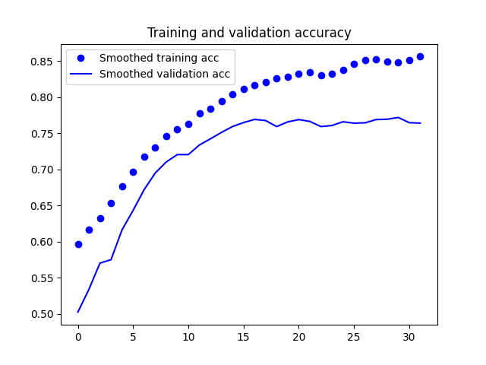
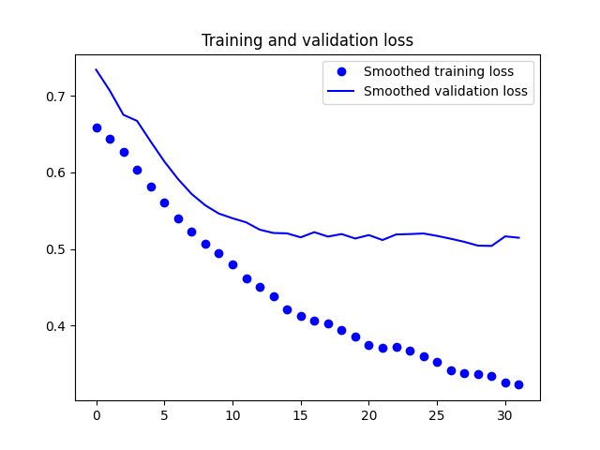
Method 3

Slide 20
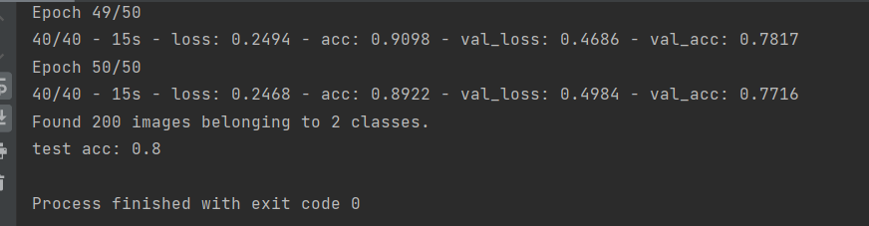
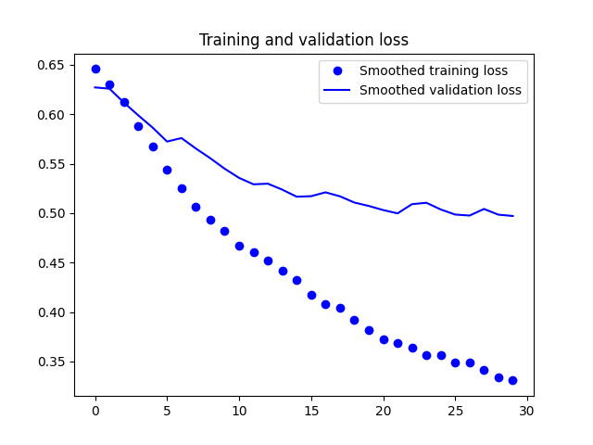
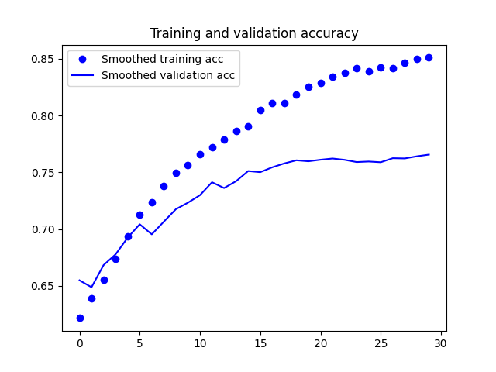
Method 4

Slide 21
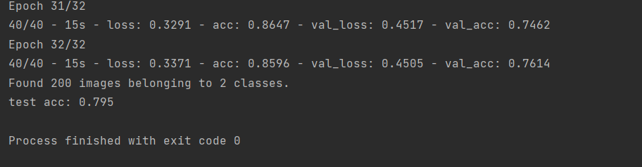
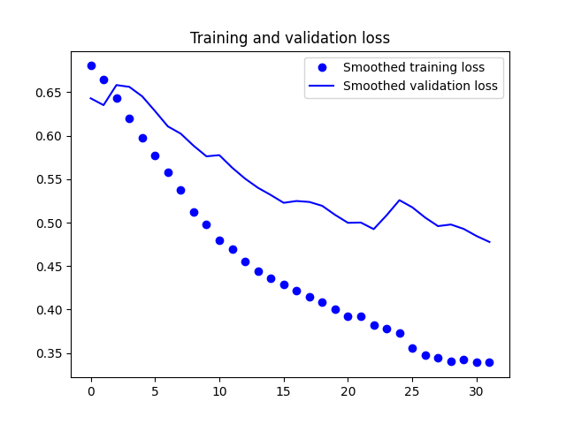
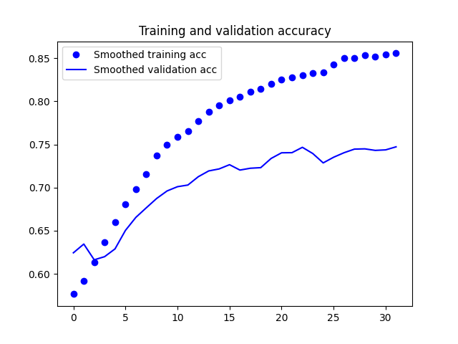
Method 5

Slide 22
So in comparation, we finally find using method 1 is the best way, and the find accuracy improve form 0.74 to 0.82

Slide 23
Finally in comparation the method1 is the best and we improve the accurancy from 72% to 82%.
Several further ways: we can find more images to make our dataset bigger so that the model can learn the different more clearly. We also need to apply our method to different images because even though method1 is the best generally, but it is surly not the best for all. We can find the way to apply different method to different kind of images to make them more contrast.

Slide 24
References
https://github.com/fchollet/deep-learning-with-python-notebooks
https://www.jianshu.com/p/5a8d12d6c649?u_atoken=cee1e1c8-70ad-485a-8638-e93dffee5296&u_asession=01AhLXEQA5oSTWX_DC3UBPG8vnxltPSPykGDdjv6ss8W3PKIiSMd-dTitWfemH9oGiX0KNBwm7Lovlpxjd_P_q4JsKWYrT3W_NKPr8w6oU7K_4r4lgkbMaV5wEyLRLX1JdPpcarp92QKzyJKyYjREPlmBkFo3NEHBv0PZUm6pbxQU&u_asig=05XoTVXqJTaX9YKqqOI_ZStp2Q578qNQld6E5ZmGAUfGxNEhiPKCW11GKS1-vzIgRUVjrIebh9M4UaN7SjKDvmDpJRmaOTBcCSF81ZpQ7w1b6BH9hoJGWJ3izK1CdMnt_vFxNNbsGn28O_89beMHW9GWpgNWwUHxiC1FJTYMbe4br9JS7q8ZD7Xtz2Ly-b0kmuyAKRFSVJkkdwVUnyHAIJzQLcvdyjlT_tNl57tKH6J16yP11iUrzYvPrqXyTsfbomWPRPQyB_SKrj-61LB_f61u3h9VXwMyh6PgyDIVSG1W_TVHoNQosLUvFFhtMrSoRr5oMI4nT4HpKECo0exjcvsNIsLWFgmR6OJQovlwVTq3OrfWR9549v8u2XEmREcqD9mWspDxyAEEo4kbsryBKb9Q&u_aref=M95L4bOgAj%2Fipl5acu%2Fx6lIuXP0%3D
http://t.csdn.cn/lpStw

Slide 25
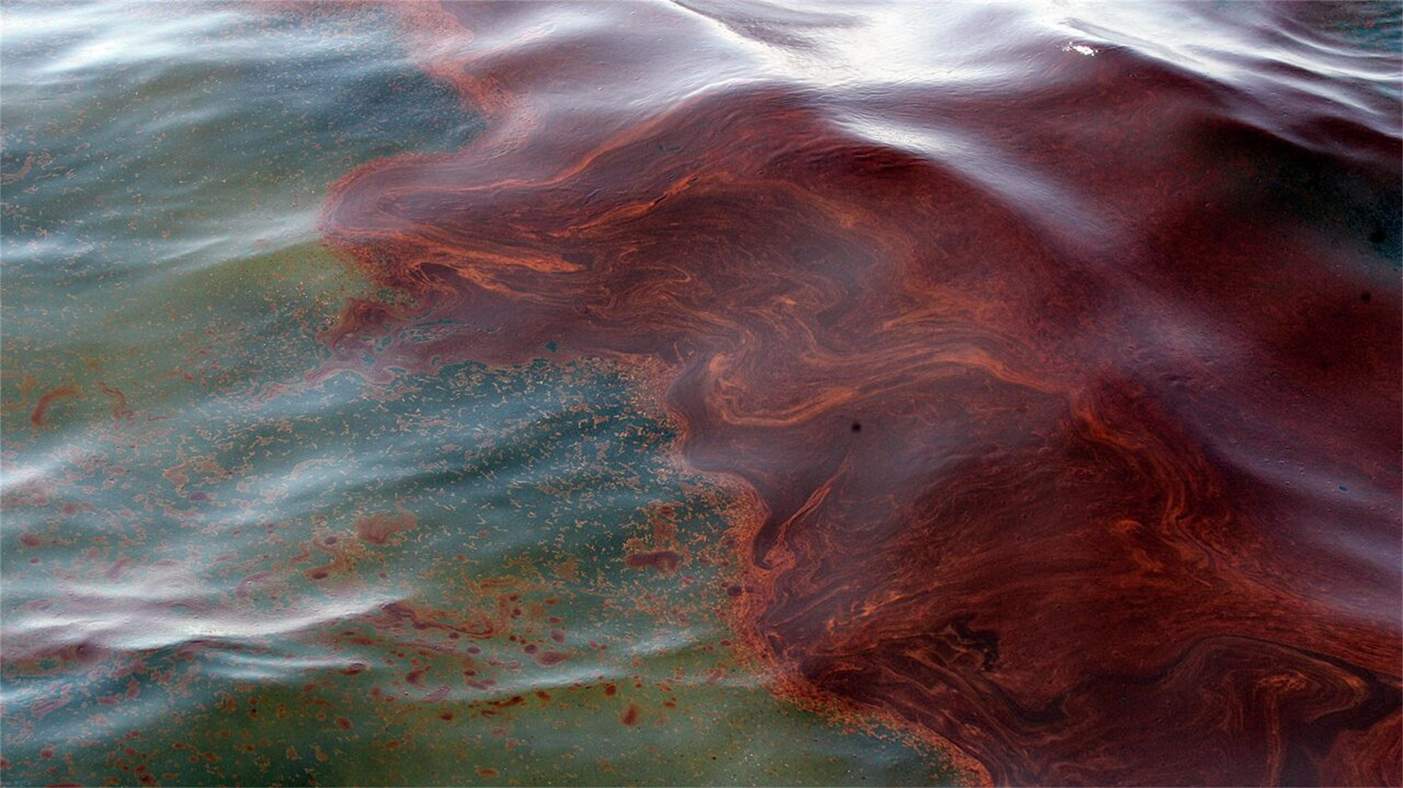
END

